Slide 1

The Pilot Of Hadoop
2017.5
XenRon

Slide 2

CONTENTS
Preliminary Topics
事前準備
01
05
Hadoop Command
02
06
Hadoop Eco System
Reference Books
03
Hadoop Architecture
Hadoop Environment
実験環境
04

Slide 3
Forgetting Curve

Slide 4
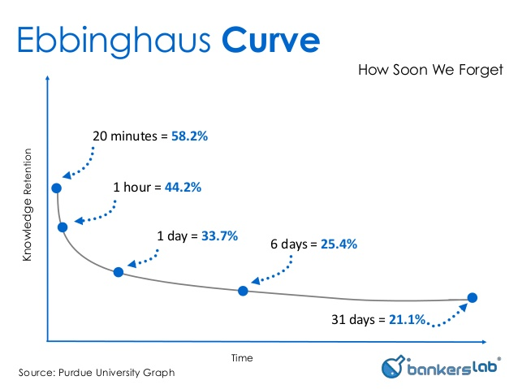
Forgetting Curve
Hermann Ebbinghaus

Slide 5
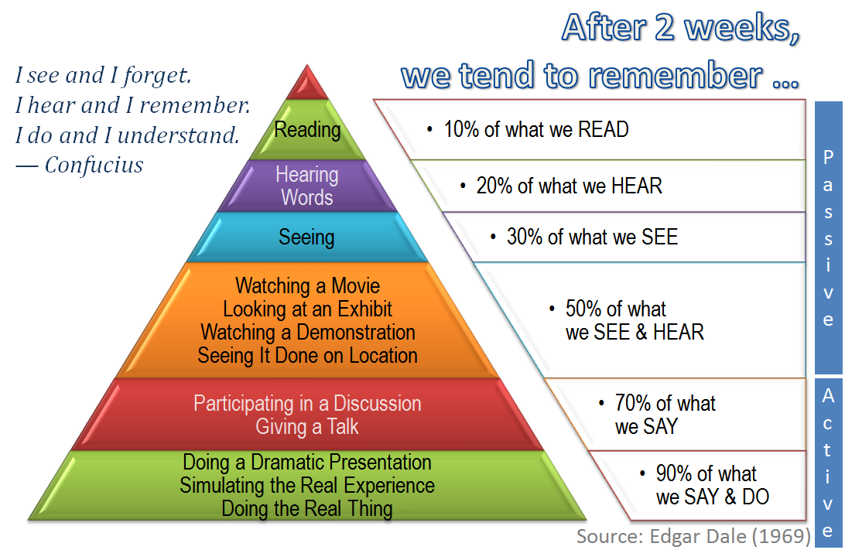
The Cone Of Learning

Slide 6
PART1
Preliminary Topics
事前準備

Slide 7



Linux
Official Website :
https://www.ubuntu.com/
http://releases.ubuntu.com/
Official Website :
https://www.centos.org/
https://www.centos.org/download/
https://wiki.centos.org/Download
Official Website :
https://www.redhat.com/en

Slide 8
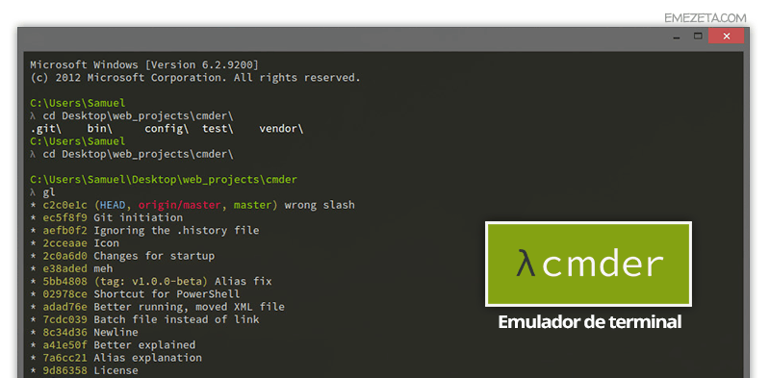
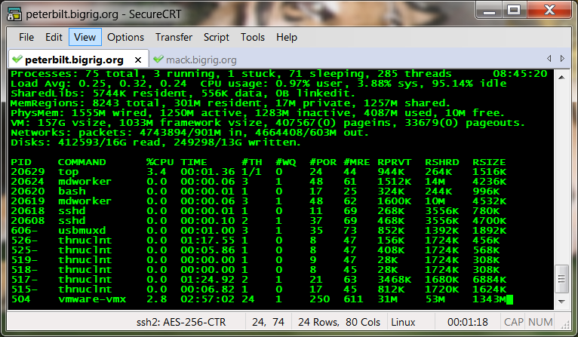
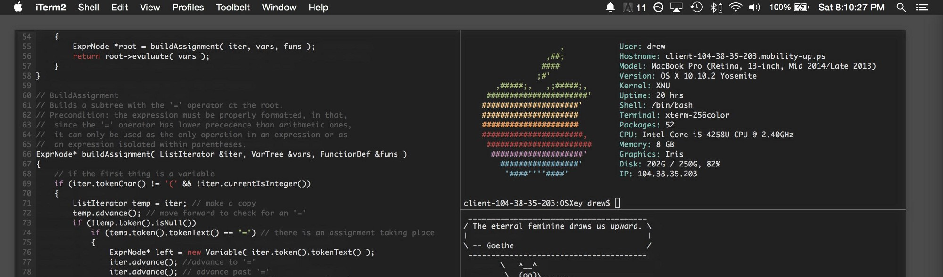
SSH Terminal

Slide 9





Virtual Machine

Slide 10
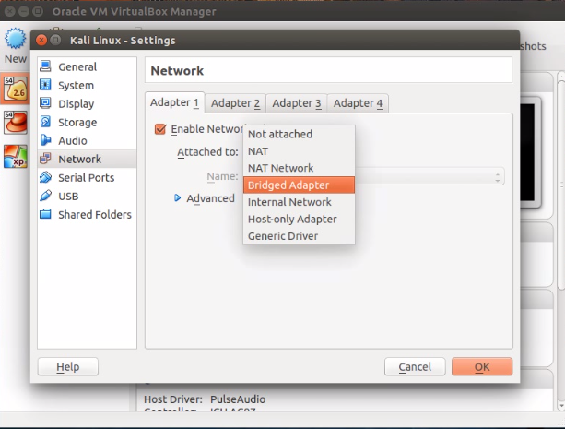
Virtual Box
Official Website :
https://www.virtualbox.org/
https://www.virtualbox.org/wiki/Downloads
Virtual networking :
https://www.virtualbox.org/manual/ch06.html

Slide 11
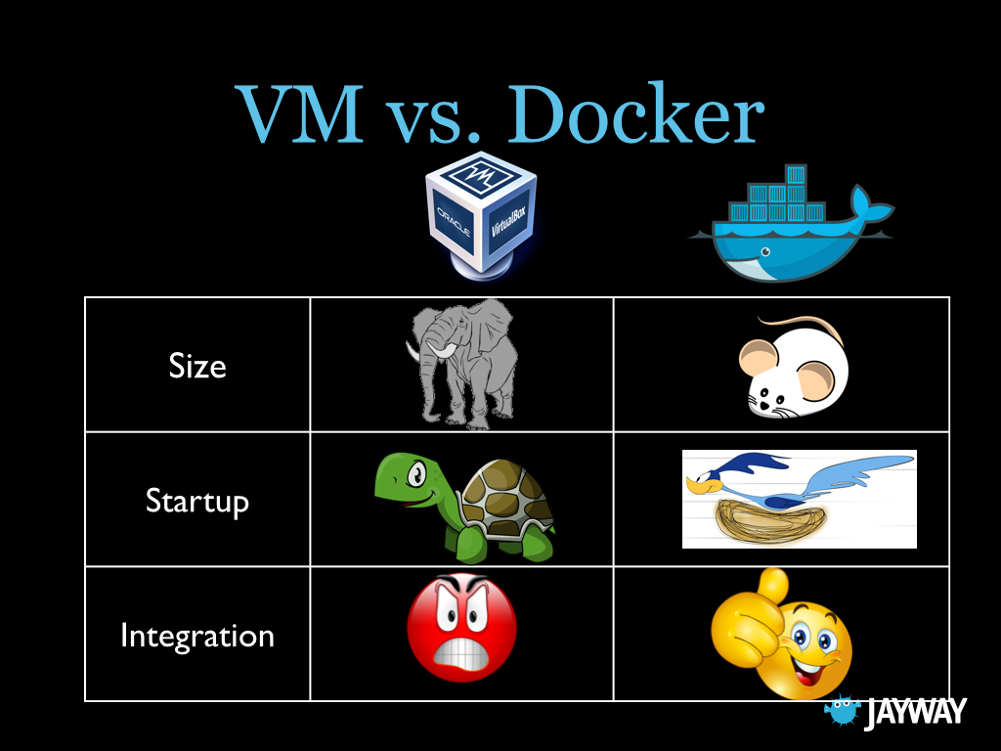
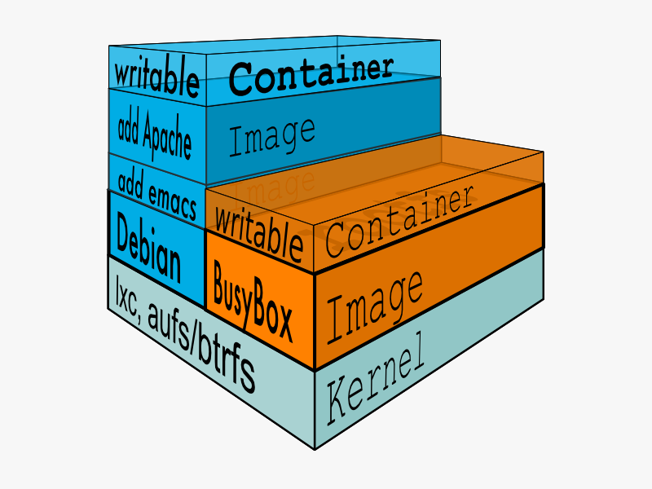
Docker

Slide 12
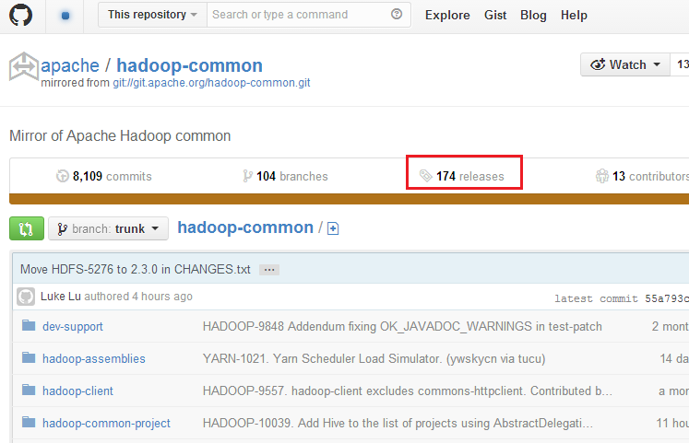

GitHub

Slide 13

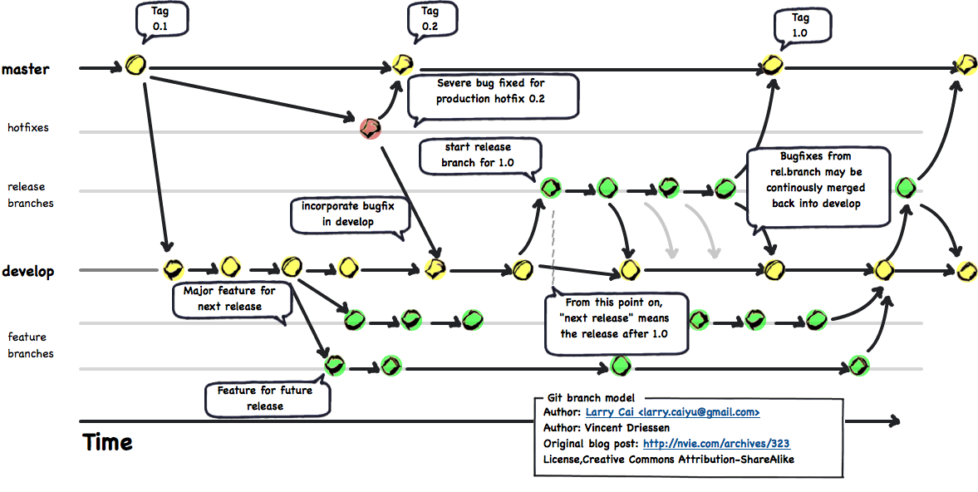
Git
Official Website :
https://git-scm.com/
The latest stable Release : v2.11.1

Slide 14
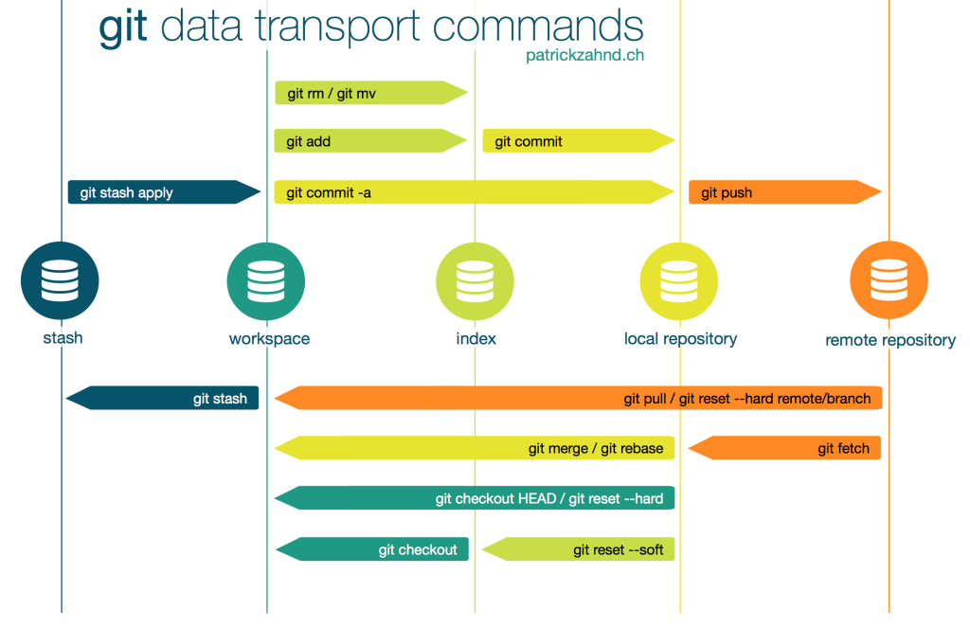
Git

Slide 15
PART2
Hadoop Eco System

Slide 16
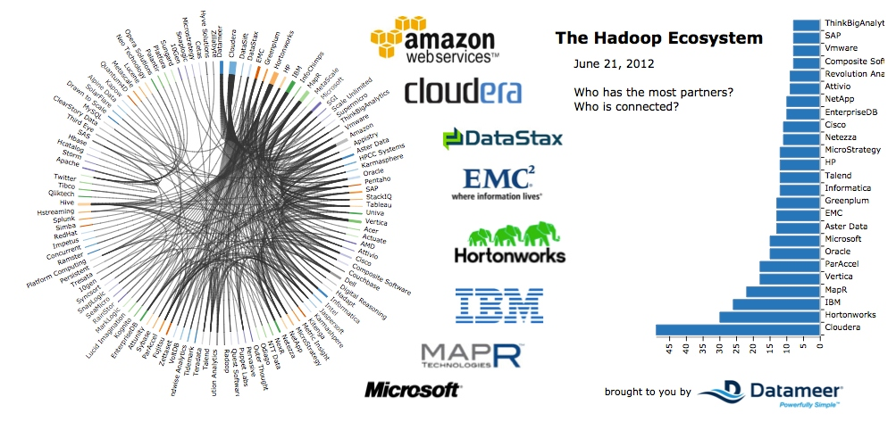
Distributions

Slide 17
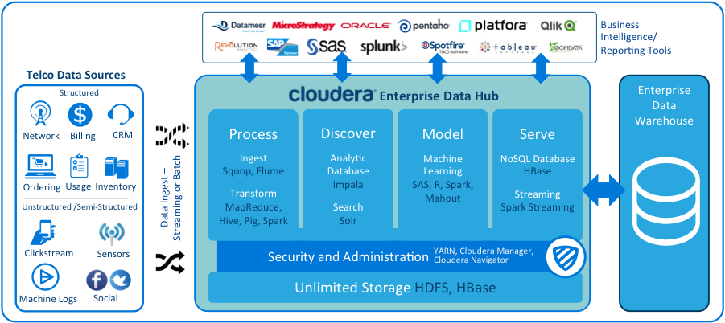
Cloudera

Slide 18
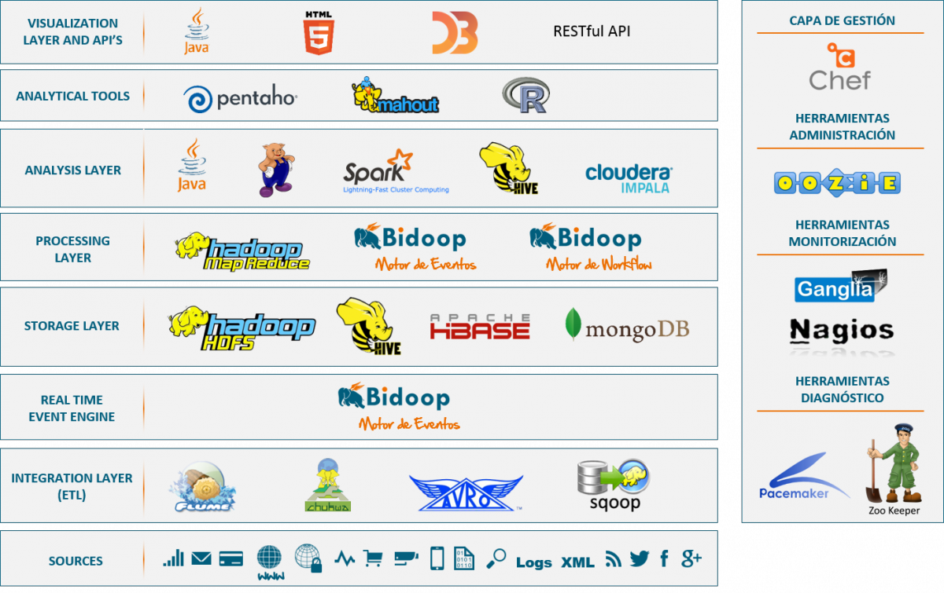
Hadoop Eco System

Slide 19
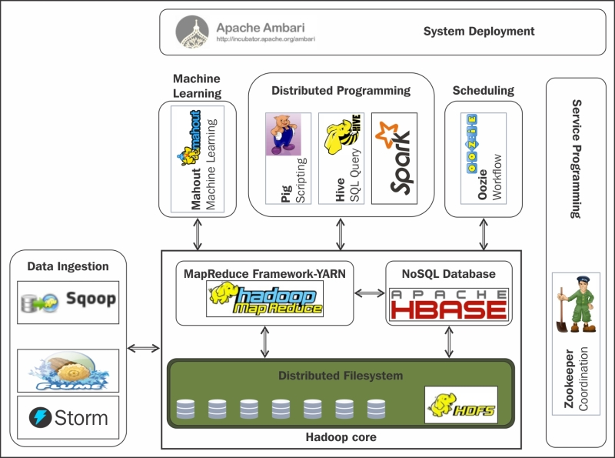
Hadoop Eco System

Slide 20
PART3
Hadoop Architecture

Slide 21
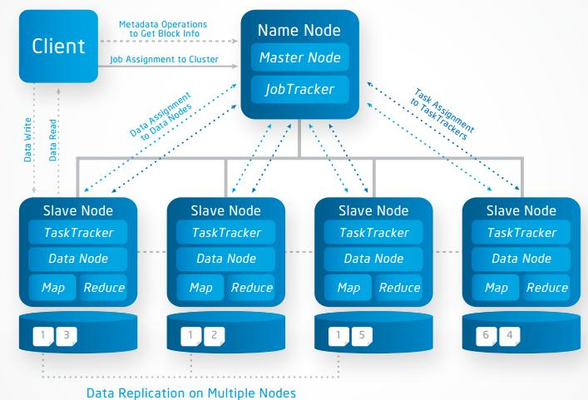
Architecture

Slide 22
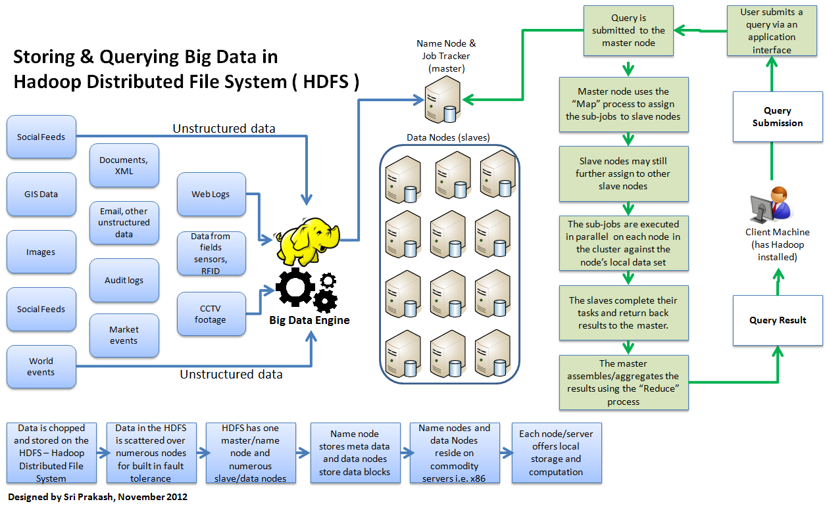
Architecture

Slide 23
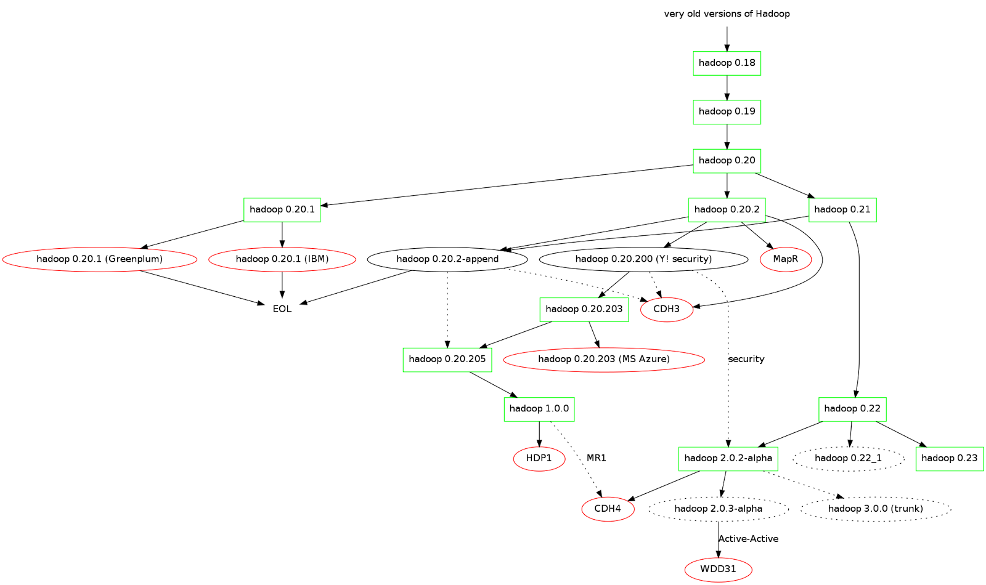
Apache Hadoop Version

Slide 24
PART4
Hadoop Environment

Slide 25
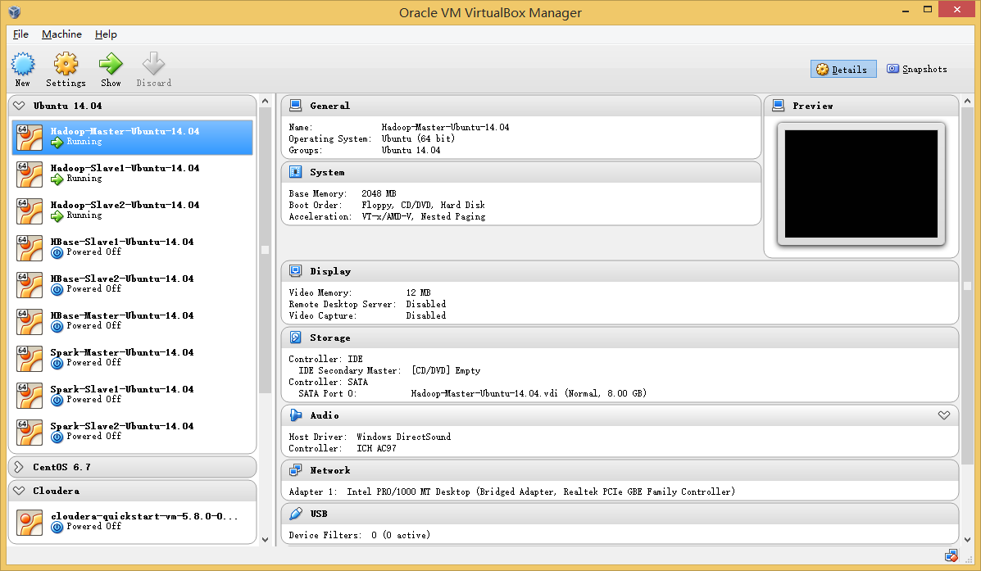
Oracle Virtual Box

Slide 26
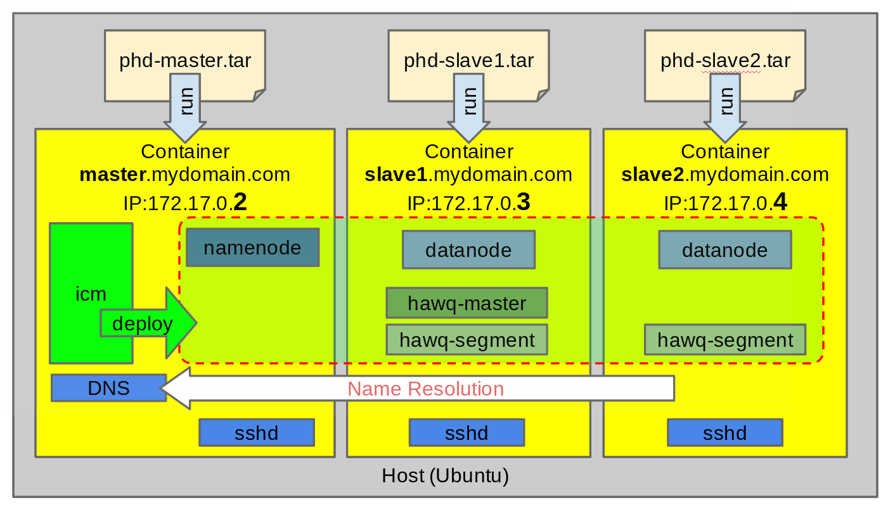
Docker

Slide 27
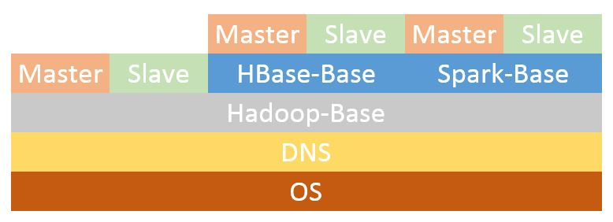
Docker

Slide 28
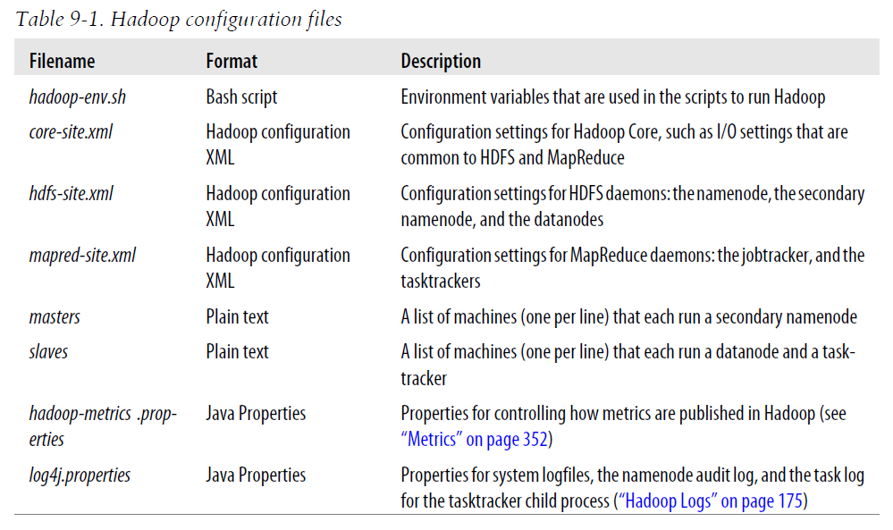
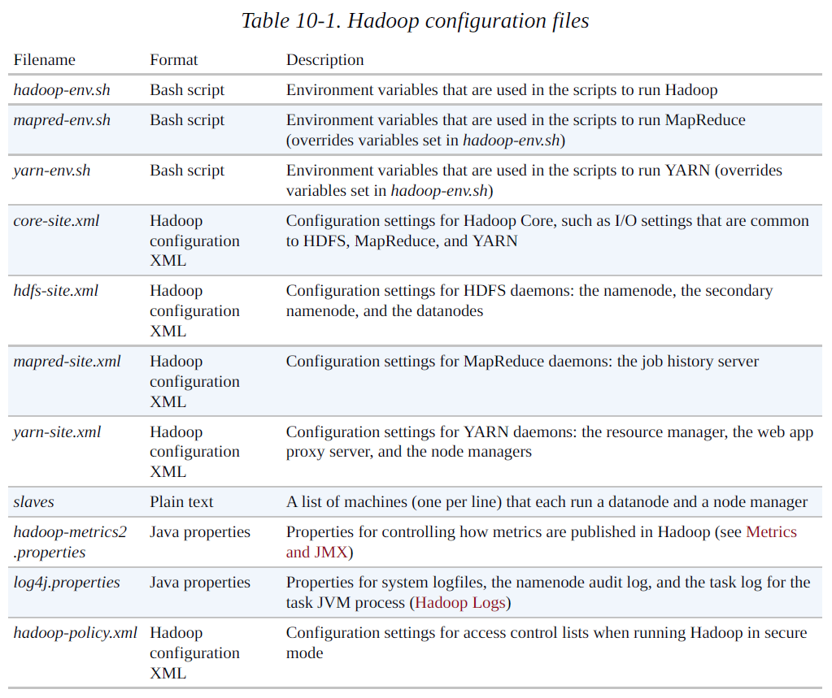
Hadoop configuration files
Hadoop 1.x
Hadoop.The.Definitive.Guide.3rd.Edition
Hadoop 2.x
Hadoop.The.Definitive.Guide.4th.Edition

Slide 29
PART5
HDFS & Hadoop Command

Slide 30
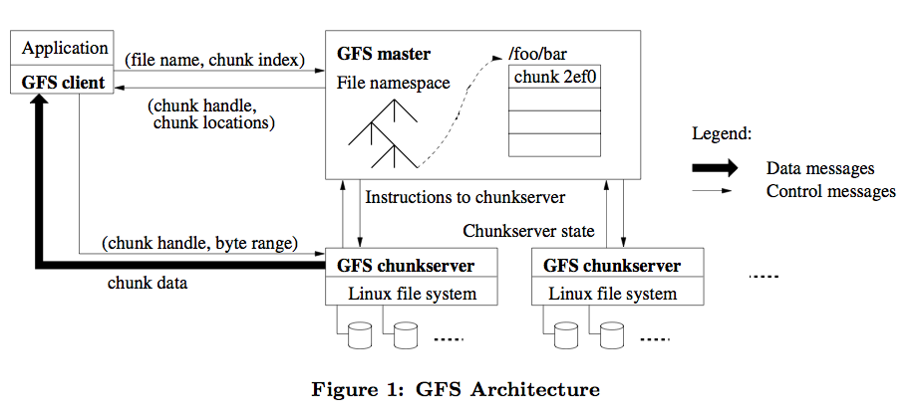
Google File System
The Google File System
https://static.googleusercontent.com/media/research.google.com/ja//archive/gfs-sosp2003.pdf

Slide 31
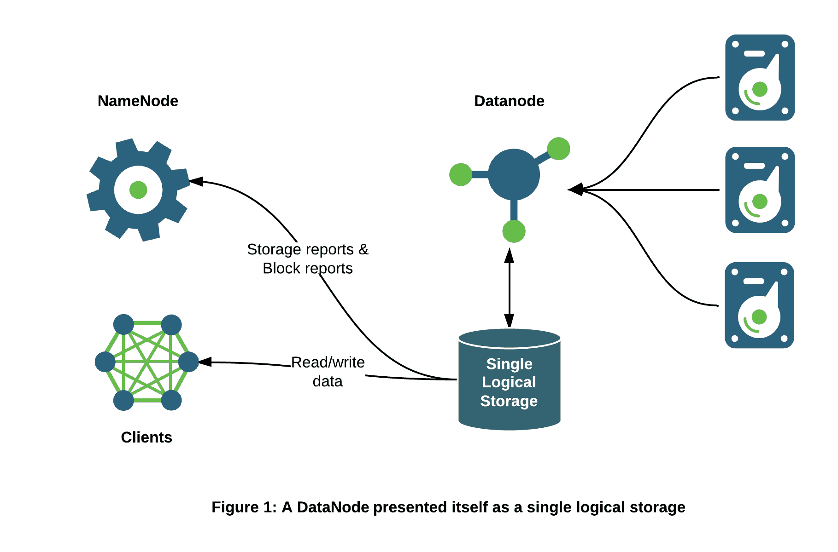
HDFS

Slide 32
HDFS

Slide 33
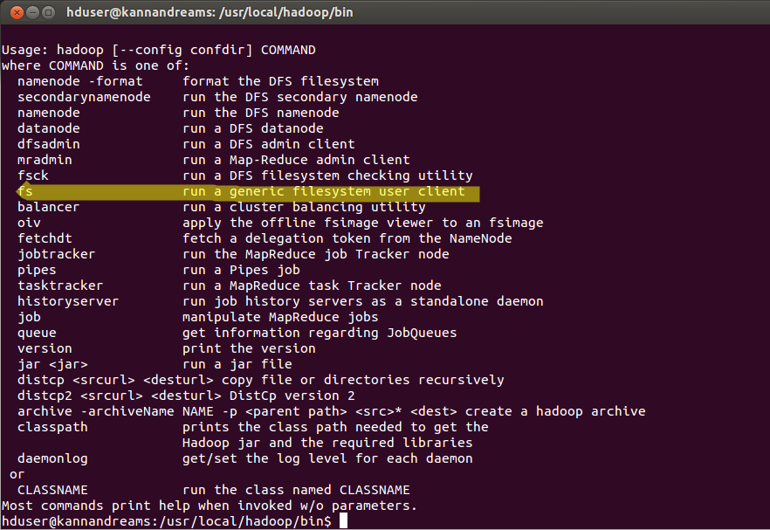
HDFS
Official Website :
https://hadoop.apache.org/docs/stable/hadoop-project-dist/hadoop-common/FileSystemShell.html
https://hadoop.apache.org/docs/r1.0.4/cn/hdfs_shell.html

Slide 34
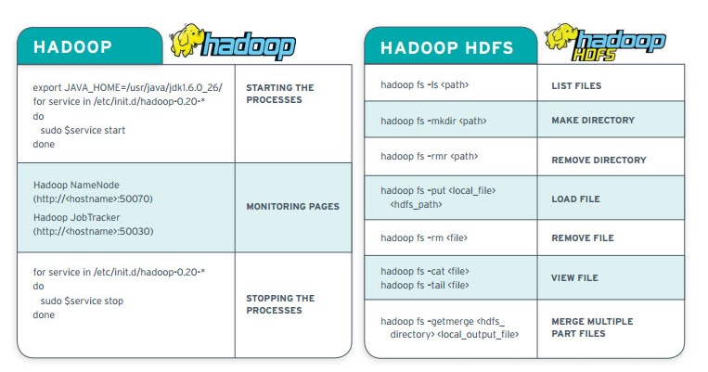
HDFS

Slide 35
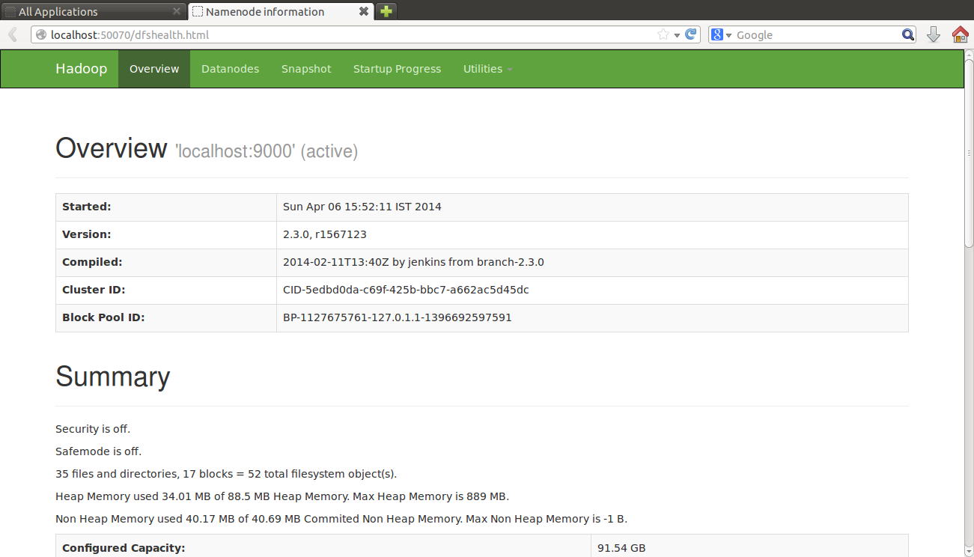
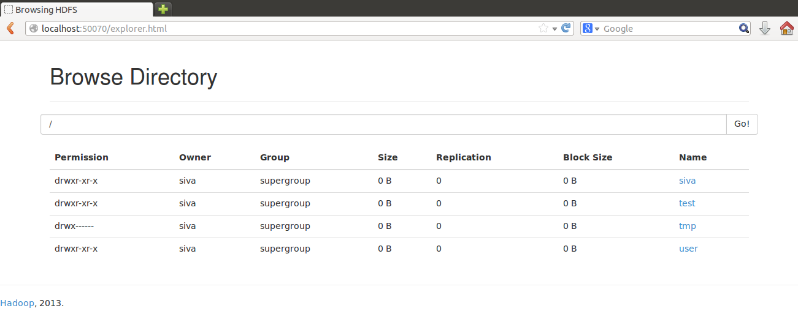
HDFS Web UI

Slide 36
PART6
Reference Books

Slide 37
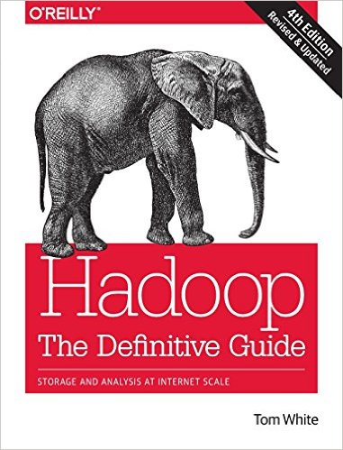
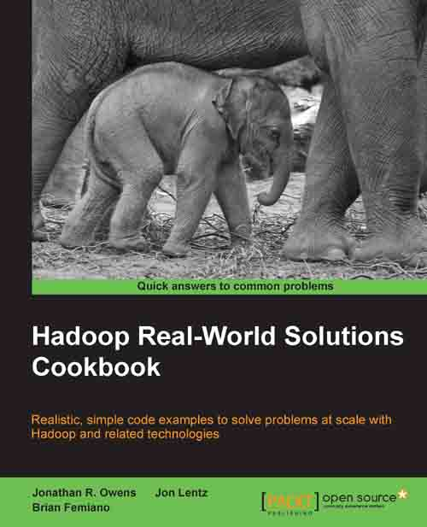
Books

Slide 38
HomeWork

Slide 39
The End

